Slide 1

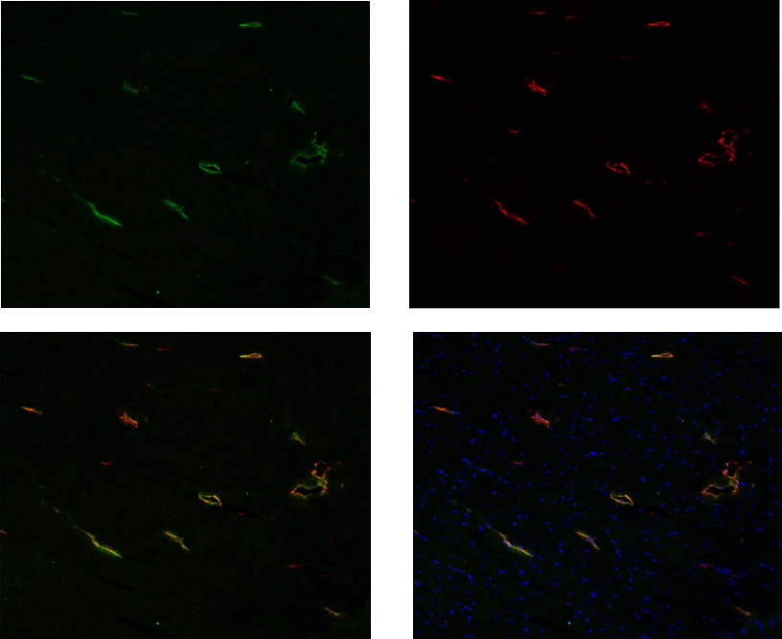
ReliaTech GmbH
Coexpression of Lyve1 and Podoplanin in rat tissue
(Cat #103-PA50AG; #104-M40 )
A
B
C
D
Figure: Rat cardiac lymphatic microvessels, labeled with antibodies against rat Podoplanin (A, green) [Cat# 104-M40, mab] and mouse LYVE-1 (B, red) [Cat# 103-PA50AG, pab]. Nuclear stain in blue. Double staining with anti-mouse LYVE-1 and anti-rat Podoplanin revealed a nice co-expression of both proteins in lymphatic endothelial cells (C, D). Note: The anti-mouse Lyve-1 polyclonal antibody shows a strong cross reaction with rat Lyve-1 protein.
The experiment was performed by the research group INSERM U1096 in Rouen, France directed by Dr Vincent Richard.
http://www.reliatech.de / orders@reliatech.de

